Slide 1
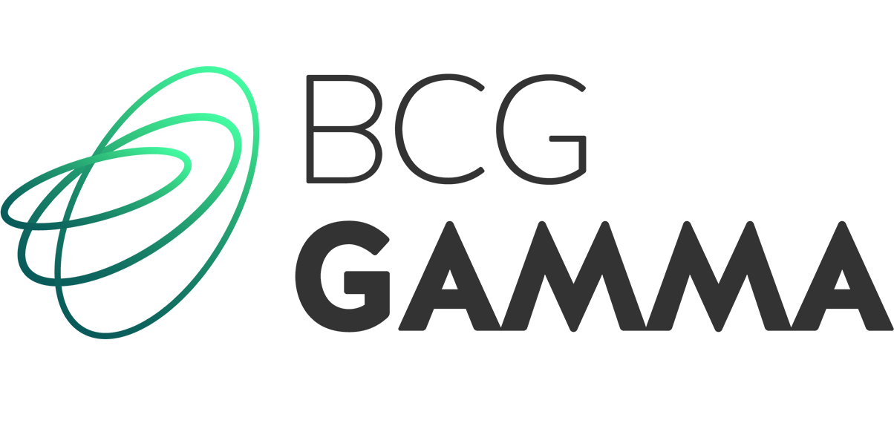
Cinepolis: Data Science Learning Session #1
Data Science Process, Data Pipelining, Feature Engineering, and Outcomes
8/23/2018

Slide 2
Agenda
Discuss learning session curriculum and schedule
Overview of the data science process and key requirements
Progress update on modeling work for frequency and menu challenge use cases
1
2
3

Slide 3
Curriculum and schedule

Slide 4
Our objectives for the bi-weekly learning session
Share our expertise
Provide a progress update
Identify key challenges
Technical deep dive/roadmaps
Collaborate and share our knowledge on modeling topics and best-in-class solutions
High level update the team on steps taken over the last two weeks and key technical developments
Discuss key challenges we have faced and steps taken to overcome those challenges
Code walk-through and process discussion of how the models are developed, refined, and deployed

Slide 5
Over the next three months we will cover a variety of topics in addition to status updates and code reviews
Aug. 23rd
Sept. 6th
Sept. 20th
Oct. 4th
Oct. 18th
Nov. 1st
Nov. 15th
Introduction
Data Preparation
Modeling and Production
Overview
Data Science overview and key topics
Sandbox creation and ERDs¹
Experiment design and measurement
Data engineering processes and flows
Identifying candidate models and testing
Validation and selection of models
Creating production systems for models
Deep dive
Frequency challenge clustering
Menu exploration rules/propensity
Sandbox creation and processing
Movie affinity model
Menu exploration CF² model
TBD
Advanced Topic
TBD
Advanced Topic
Entity-Relationship Diagram – a description of how objects are related to each other in a database and how that information can be mined for insight
CF – Collaborative Filtering

Slide 6
Our Journey to today

Slide 7
We identified a MVP plan with three key objectives
MVP Scope
Objectives
For customers: Improve relevance and engagement
Change behaviour through optimized value proposition (promo, message, channel)
4 months of pilots
Test and learn & capability build
For Cinépolis:
Validate we can…
Learn from personalized customer behaviour and optimize offers value proposition
E-mail and push notifications
Dedicated sandbox ~18% of active TCC base
For the team: Improve ways of working
Enabling automation and building new capabilities to drive efficiency

Slide 8
Three use cases with high potential were selected based on execution feasibility and impact
Higher
Example: Frequency Challenge full potential
1st priority use cases
Format /
menu
exploration
Optimized flash
offers
Value potential
Incremental margin p.a.¹
Geolocation
promotions
Frequency
challenges
2nd priority
Abandoned
cart reminders
Lapsed members
Frequency
Social network
interactions
High risk
customers
Brand engagement
Rating feedback
TCC acq.
Service recovery
Churn Prevention
Partnership
offers
Menu challenge
Cross-sell/Up-sell
Lower
Cinépolis acq.
Curated messages
Customer Acquisition
Activity challenge
Spend challenge
Slower
(>12mos)
MVP implementation time to market
Faster
(<4mos)
Data, tech and analytics capabilities required
Source: Club Cinépolis BR 2018; App & Webpage Cinépolis Analytics; Cinépolis Category Management 2017; Cinépolis Mexico P&L 2017; BCG Analysis
Notes:
Time to capture impact

Slide 9
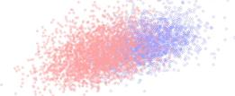
A roadmap was created to iterate and increase the complexity of modeling for each of the use cases
September
October
November
Initial tests
Incremental learnings
Advanced solutions
Main Objective | Stress test operations & strengthen use cases | Leverage learnings from the first test to refine targeting and build initial models | Begin the journey toward 1-1 personalization
Supporting Models | Test and learn Business Rule Segmentation | K-Nearest Neighbor clustering Propensity models (e.g. product propensity model, buy together, etc) Lookalike models | Movie affinity Collaborative filtering
Examples:
Buy
Buy
Buy
Similar clients
Buy
Buy
Recommend
Increasing complexity and sophistication

Slide 10
Data Science overview

Slide 11
Successful data science initiatives integrate three key functional areas: technology, data, and modeling
Technology and infrastructure
Data collection and analysis
Experiments, modeling, and results
Requires flexible infrastructures, new technologies, and capability to scale
Well defined and high quality data that is consistently collected and maintained
Defining problems to solve, framing experiments to run, and collecting/ validating results
There is a tendency for data professionals to focus on modeling at the expense of data collection or technology infrastructure – this can be one of the major failure points in analytics projects

Slide 12
Successful projects find themselves in virtuous cycles where each component drives another
More accurate modeling drives the need for more technology to scale up the insights and outputs of those models, in turn driving additional data collection and understanding of the customer
Technology
Data collection
and analysis
Improved technology allows more data to be analyzed more quickly, improving the value of the data generated and reducing the cost to maintain the data set
Increased availability of data improves the quality of model outputs and drives additional value. The ability to analyze more data drives the need for more technology
Experimentation
and modeling

Slide 13
Many steps have to be taken before a value-adding model can be constructed and implemented
Enabling sustainable value creation
Generating and capturing value
Data exploration
Feature development
Model candidate identification
Scaling and execution
Identify what data exists
Develop new understandings
Define the problem's solution
Scale the output and execute
Explore if the question can be answered with the current data
Identify which data is usable and of appropriate quality
Combine the data create new metrics e.g. average purchases last three months, favorite product, most frequently visited location
Determine if there's an appropriate model to predict a given outcome – for example, if a customer will purchase a given class of product
Transform the entirety of the prior work into a sustainable system that can be sustained with limited updates
Typical process time is 3 to 6 months for new use cases and is highly iterative

Slide 14
Progress update

Slide 15
Each use case family has been detailed to specific test use cases with clear hypotheses to validate in pilots
Today's discussion topic
Frequency challenge
Menu exploration
Flash Offers
Description
Hypothesis
Unlock a reward after a personalized # of visits during a specific period of time
Using game dynamics to deliver promotions based on individual frequency levels we can increase the customer frequency
Unlock a reward after purchasing a personalized set of concession products
Using game dynamics to deliver promotions based on individual consumption patterns we can increase basket size of up-sell
Offer a special discount for box office tickets during a short period of time
Delivering short fused offers promoting movies tailored to client preferences can drive an additional impulse visit

Slide 16
Customer clustering is to improve our understanding of customer behavior for the next frequency challenge
Clustering provides insight into how customers organically behave…
…so we can drive business value through improved offers/targeting
Customers are grouped into similar behavior segments on multiple dimensions
Each segment receives a distinct score for concession/frequency preference
Each individual receives a sub-segment score based on recent behavior
Well defined clusters allow us to target creatives and offers to each group in a sustainable way
Preferences drive marketing personalization through better targeting
Sub-segment scores can be used to test the impact of recent behaviors on offer acceptance

Slide 17
Technical walkthrough

